Slide 1

Lecture 05 JDBC Database Access
Chapter 14: JDBC- Java Database Connectivity
( 4 slots)
References:
Java-Tutorials/tutorial-2015/jdbc/index.html
Java Documentation, the java.sql package

Slide 2
Why should you study this lecture?
In almost all large applications. Data are organized and stored in databases which are managed by database management systems (DBMS) such as MS Access, MS SQL Server, Oracle, My SQL,…
Do you want to create Java applications which can connect to DBMSs?
Database programming is a skill which can not be missed for programmers.

Slide 3
Objectives
Introduction to databases
Relational Database Overview
JDBC and JDBC Drivers
Steps to develop a JDBC application.
Demonstrations.

Slide 4
Contents
1- Database and DBMS
2- Relational Database Overview
3- JDBC and JDBC Drivers
4- Steps to develop a JDBC Application
5- A Demonstration

Slide 5
1- Database and DBMS
Database is a collection of related data which are stored in secondary mass storage and are used by some processes concurrently.
Databases are organized in some ways in order to reduce redundancies.
DBMS: Database management system is a software which manages some databases. It supports ways to users/processes for creating, updating, manipulating on databases and security mechanisms are supported also.
DBMS libraries (C/C++ codes are usually used) support APIs for user programs to manipulate databases.

Slide 6
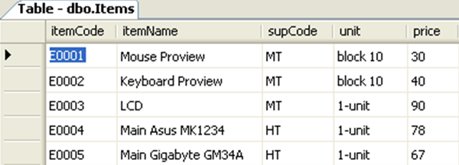
2- Relational Database Overview
Common databases are designed and implemented based on relational algebra (set theory).
Relational database is one that presents information in tables with rows and columns.
A table is referred to as a relation in the sense that it is a collection of objects of the same type (rows).
A Relational Database Management System (RDBMS)- such as MS Access, MS SQL Server, Oracle- handles the way data is stored, maintained, and retrieved.

Slide 7

RDBMS: Structure Query Language (SQL)
Data Definition Language (DDL):
CREATE…/ ALTER…/ DROP…
3 languages:
Data Manipulating Language (DML):
SELECT…/ INSERT INTO … / UPDATE … / DELETE
Data Control Language (DCL):
GRANT…/ REVOKE … / DENY…

Slide 8
RDBMS: SQL…
Common DML queries:
SELECT columns FROM tables WHERE condition
UPDATE table SET column=value,… Where condition
DELETE FROM table WHERE condition
INSERT INTO table Values ( val1, val2,…)
INSERT INTO table (col1, col2,…) Values ( val1, val2,…)

Slide 9
3-JDBC and JDBC Driver
The JDBC™ API was designed to keep simple things simple. This means that the JDBC makes everyday database tasks easy. This trail walks you through examples of using JDBC to execute common SQL statements, and perform other objectives common to database applications.
The JDBC API is a Java API that can access any kind of tabular data, especially data stored in a Relational Database.

Slide 10
JDBC and JDBC Driver…
JDBC APIs has 02 parts in the java.sql package.
Part | Details | Purposes
JDBC Driver (Thư viện) | DriverManager class | Java.lang.Class.forName(DriverClass) will dynamically load the concrete driver class, provided by a specific provider for a specific database. This class implemented methods declared in JDBC interfaces. The class DriverManager will get a connection to database based on the specific driver class loaded.
JDBC API | Interfaces: Connection, Statement ResultSet DatabaseMetadata ResultSetMetadata Classes SQLException | For creating a connection to a DBMS For executing SQL statements For storing result data set and achieving columns For getting database metadata For getting resultset metadata
Refer to the java.sql package for more details in Java documentation

Slide 11
JDBC and JDBC Driver…
Java App.
Connection con
Statement stmt
ResultSet rs
DriverManager
executeQuery()
createStatement()
Process rs
getConnection()
Specific JDBC Driver implement interfaces
(loaded dynamically by java.lang.Class)
Database
Model of a JDBC App.

Slide 12
JDBC and JDBC Driver…
DBMS provider/developer will supply a package in which specific classes implementing standard JDBC driver (free).
Based on characteristics of DBMSs, four types of JDBC drivers are:
Type 1: JDBC ODBC
Type 2: Native API
Type 3: Network Protocol
Type 4: Native Protocol
Type 1 and Type 4 are populated.

Slide 13
Type 1-Driver : JDBC-ODBC Bridge
Application
Java Application
Microsoft Technology
Type I JDBC-ODBC Bridge
SQL Command
Result Set
Mapping
<Datasource name, Data file>
MS ODBC Driver
MS Access Driver
MS Excel Driver
MS SQL Srv Driver
Oracle Driver
…
Database
Database
Database
Database

Slide 14
Type 1-Driver : JDBC-ODBC…
This package is in the JDK as default.
Translates JDBC APIs to ODBC APIs
Enables the Java applications to interact with any database supported by Microsoft.
Provides platform dependence, as JDBC ODBC bridge driver uses ODBC
JDBC-ODBC bridge is useful when Java driver is not available for a database but it is supported by Microsoft.
Disadvantages
Platform dependence (Microsoft)
The performance is comparatively slower than other drivers
Require the ODBC driver and the client DB to be on the server.
Usage: DSN is registered to use connecting DB (a data source is declared in Control Panel/ODBC Data sources)

Slide 15
Type 2-Driver: Native API
Provides access to the database through C/C++ codes.
Developed using native code libraries
Native code libraries provide access to the database, and improve the performance
Java application sends a request for database connectivity as a normal JDBC call to the Native API driver
Establishes the call, and translates the call to the particular database protocol that is forwarded to the database
Application
Java Application
Type II JDBC Driver
SQL Command
Result Set
Native Database Library
Proprietary Protocol
Database
Notes:
Proprietary: độc quyền/ giữ bản quyền
Nhược điểm: Do driver này chạy nhanh nên nó gọi Hàm API của hệ điều hành

Slide 16
Type 3-Driver: Network Protocol
Application
Use a pure Java client and communicate with a middleware server using a database-independent protocol.
The middleware server then communicates the client’s requests to the data source
Manages multiple Java applications connecting to different databases
Java Application
Type III JDBC Driver
Result Set
Middleware
JDBC
Database
Notes:
Ứng dụng cho các doanh nghiệp lớn như Ngân hàng, Bệnh viện

Slide 17
Type 4-Driver: Native Protocol
Application
Communicates directly with the database using Java sockets
Improves the performance as translation is not required
Converts JDBC queries into native calls used by the particular RDBMS
The driver library is required when it is used and attached with the deployed application (sqlserver 2000: mssqlserver.jar, msutil.jar, msbase.jar; sqlserver 2005: sqljdbc.jar; jtds: jtds.jar …)
Independent platform
Java Application
Type IV JDBC Driver
SQL command
Result Set
use Proprietary protocol
Database
Notes:
Loại được sử dụng phổ biến nhất.
Sử dụng socket để truy vấn dữ liệu.

Slide 18

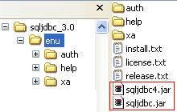
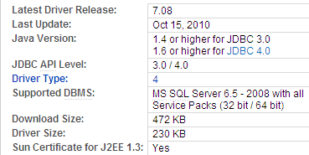
Download Type 4 SQL Server JDBC
Google : Microsoft SQL Server JDBC Driver
MS SQL Server 2008
MS SQL Server 2005
Setup

Slide 19
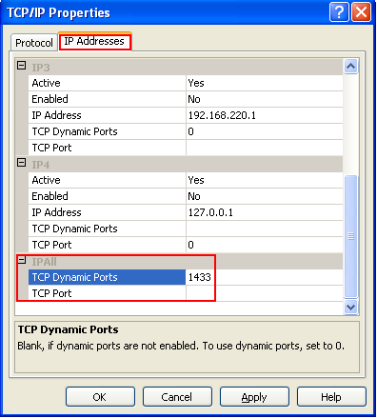
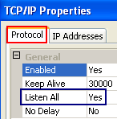
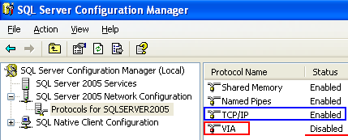
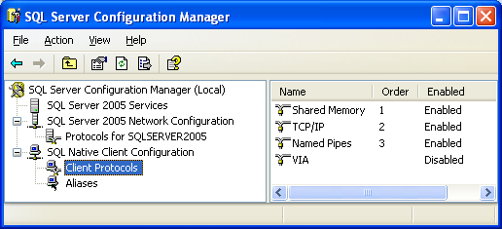
Configure Ports, Protocols for SQL Server
Enable Server protocols and port
Right
click
Attention: Disable VIA
Enable client protocols and port

Slide 20
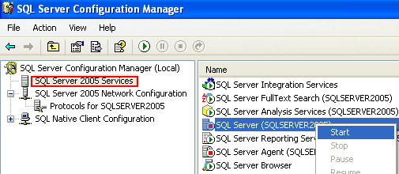
Configure Ports, Protocols for SQL Server…
Stop then restart SQL Server and SQL Server Agent for settings are affected.
Right
click

Slide 21
4-Steps to Develop a JDBC Application
Step | Description | Use ( java.sql package) | Methods
1 | Load JDBC Driver | Java.lang.Class | forName(…)
2 | Establish a DB connection | java.sql.Connection java.sql.DriverManager | DriverManager getConnection(…) → Connection
3 | Create & execute SQL statements | java.sql.Statement java.sql.PrepareStatement java.sql.CallableStatement | execute(…) executeQuery(…) → SELECT executeUpdate(…) → INSERT/UPDATE/DELETE
4 | Process the results | java.sql.ResultSet | first(), last(), next(), previous() getXXX(..)
5 | Close | ResultSet, Statement, Connection | close()

Slide 22
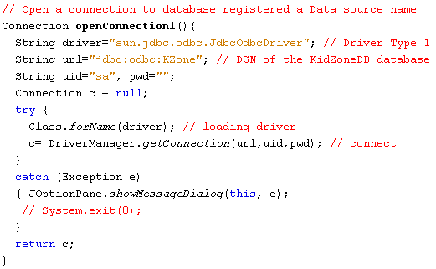
Step 1: Register JDBC Driver Step 2: Establish a connection to DB
Driver Class
Driver Type 1 with Data Source Name registered in ODBC
Attention to the syntax of URL

Slide 23
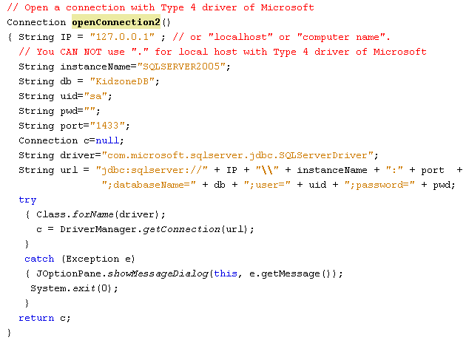
Step 1: Register JDBC Driver Step 2: Establish a connection to DB
Driver type 4 (MS SQL Server)
Driver Class
Attention to the syntax of URL
Notes:
“jdbc: sqlserver://localhost:1456; databaseName=PRJ311”,”sa”,” ”)

Slide 24
Step 3: Create &Execute a SQL statement
String sql1 = “SELECT columns FROM table1, table2, … WHERE condition”;
String sql2 = “UPDATE table SET column = value, … WHERE condition”;
String sql3 = “INSERT INTO table VALUES ( val1, val2, … )” ;
String sql4 = “INSERT INTO table (col1, col2, col3) VALUES ( val1, val2, val3)” ;
String sql5 = “UPDATE table SET col1 = ?, col2=? WHERE condition”;
// Connection con was created
Statement stmt= con.createStatement();
ResultSet rs= stmt.executeQuery(sql1);
int numOfInfectedRows = stmt.executeUpdate(sql2);
int numOfInfectedRows = stmt.executeUpdate(sql3);
int numOfInfectedRows = stmt.executeUpdate(sql4);
PreparedStatement pStmt = con.preparedStatement(sql5);
pStmt.setXXX (index, val); // from 1
int numOfInfectedRows = pStmt.executeUpdate(); // no argument

Slide 25
Step 4: Process the results
BOF
Move the current row:
boolean next(), previous(), first(), last()
Default: Result set moves forward only.
Record 1
Record 2
Get data in columns of the current row:
TYPE getTYPE ( int columnIndex) // begin from 1
TYPE getTYPE ( String columnLabel)
Record 3
…..
…..
…..
SELECT desc AS description FROM T_employee
Column name: desc
Column Label: description
EOF
ResultSet
At a time, resultset maintains a current position. When the resultset is initialized, the position is the BOF position. An exception is thrown when the current position is out of its scope.

Slide 26
Step 5: Close the connection
Opening Order:
Connection
Statement
ResultSet
Closing Order:
ResultSet
Statement
Connection
Attention!!!
At a time, a connection can be bound with ONLY ONE result set.
An exception will be thrown if we try binding a connection with another result set.
EX:
String sql1 =“SELECT…”;
String sql2 =“SELECT…”;
ResultSet rs1= stmt.executeQuery(sql1);
ResultSet rs2= stmt.executeQuery(sql2); ➔ EXCEPTION
You should close the rs1 before trying get the rs2 result set
Solution: Transfer data in the rs1 to ArrayList (or Vector) then close rs1 before get new data to rs2.

Slide 27
Demonstrations

Slide 28
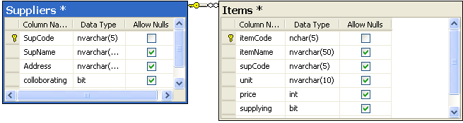
(Demo 1) Create database
Use MS Access or MS SQL Server 2005
Database name: ItemDB
Tables and Relationship:
You can download this database file from CMS.

Slide 29
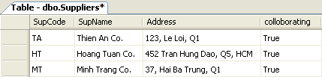
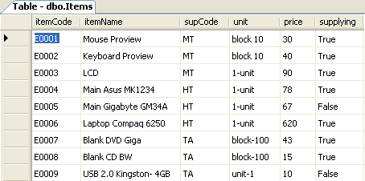
(Demo 1) Create database…
Initial data:

Slide 30
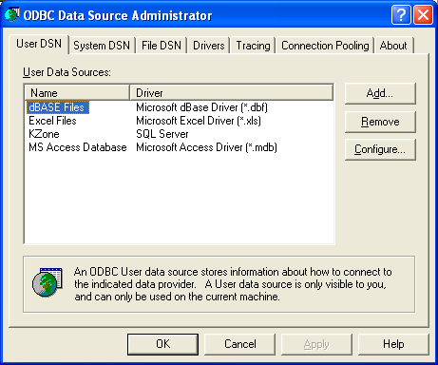
(Demo 2) Register a DSN
(1) Open the Control Panel
(2) Select Administrative Tools.
(3) Select Data Sources (ODBC)
(4) Select User DSN or System DSN tab.
(5) Click the Add button.

Slide 31
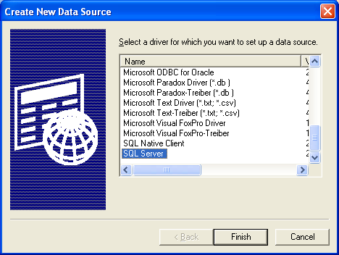
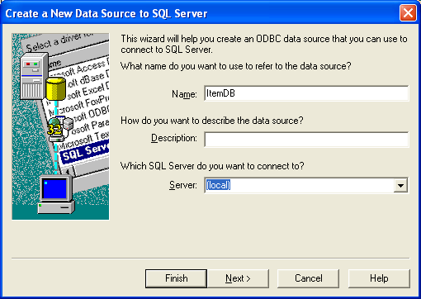
(Demo 2) Register a DSN…
Select file type
Click the Finish button.
Give a data source name, such as ItemDB
Select server (SQL Server)
Click the Finish button

Slide 32
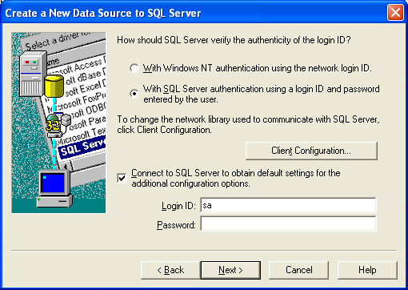
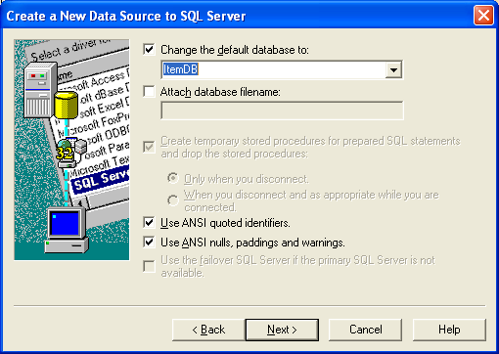
(Demo 2) Register a DSN…
Select security mode.
Supply Login ID and Password
Click the next button
Select database.
Click the next button

Slide 33
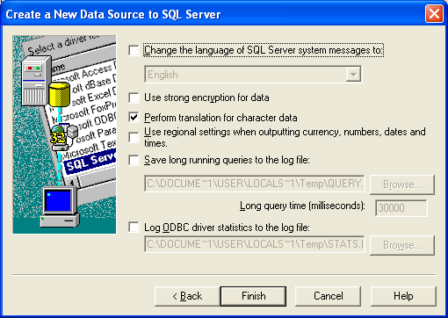
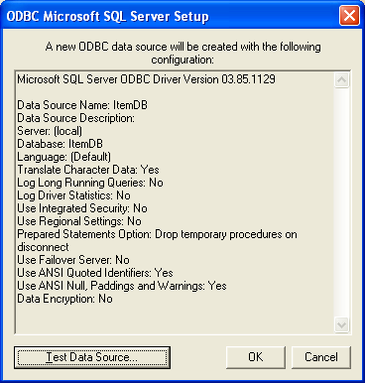
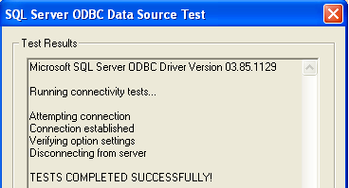
(Demo 2) Register a DSN…
Click the Finish button
Click the Test…button

Slide 34
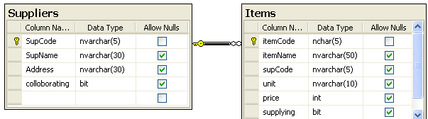
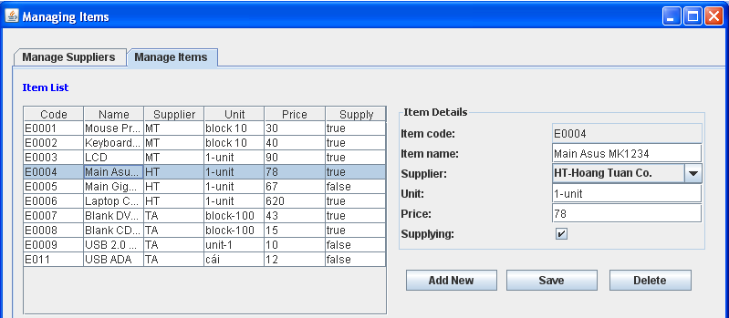
(Demo 3) Develop the program for managing items using MS Sql Server JDBC
Database:
Program GUI

Slide 35
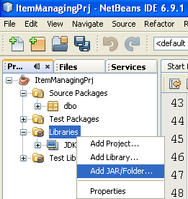
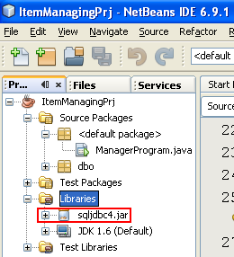
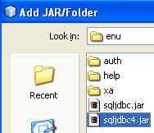

Demo 3…
Add MS SQL Server JDBC to the NetBeans:

Slide 36
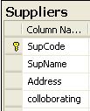

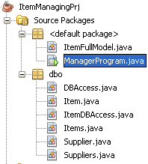

Demo 3…: Class Diagram
Supplier
Suppliers
DBAccess
Used to combobox model
ItemDBAccess
Item
Items
ItemFullModel
Used to table model

Slide 37
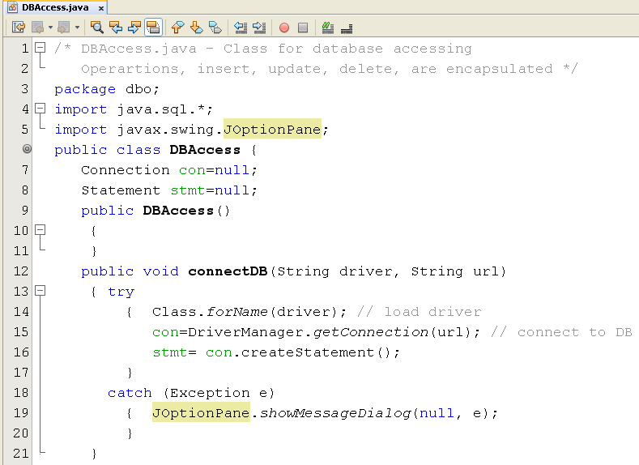
Demo 3…

Slide 38
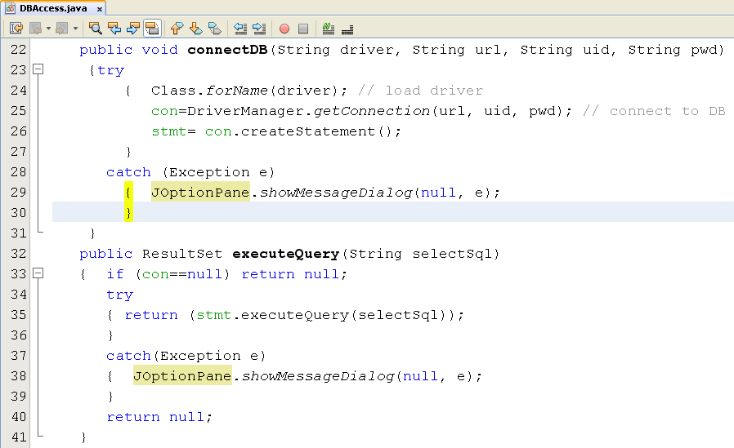
Demo 3…

Slide 39
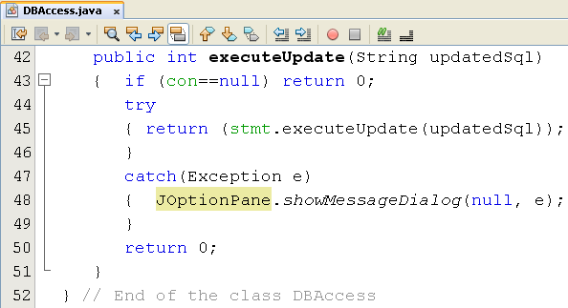
Demo 3…

Slide 40
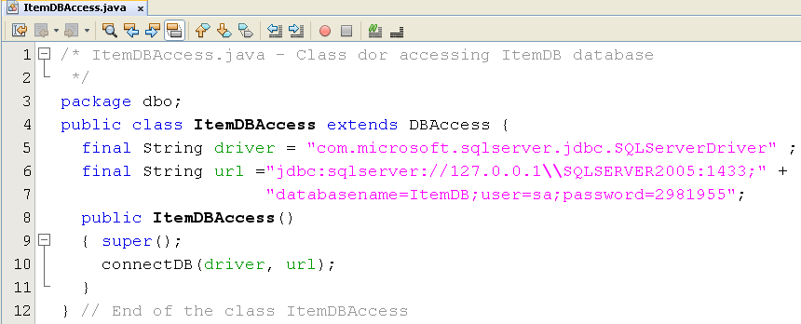
Demo 3…

Slide 41
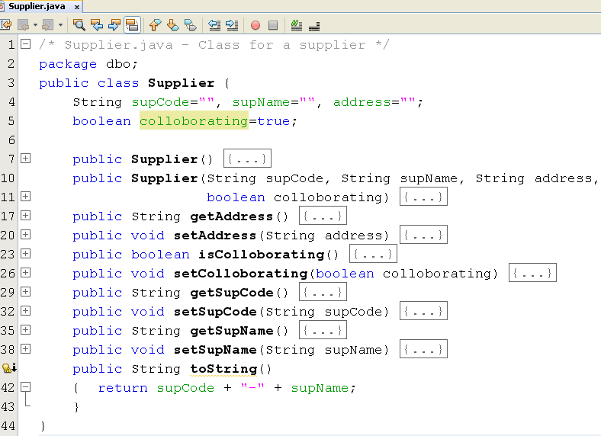
Demo 3…

Slide 42
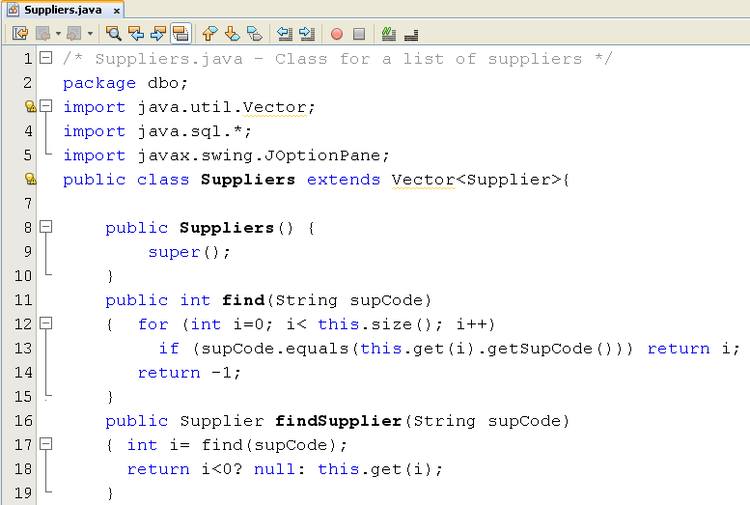
Demo 3…

Slide 43
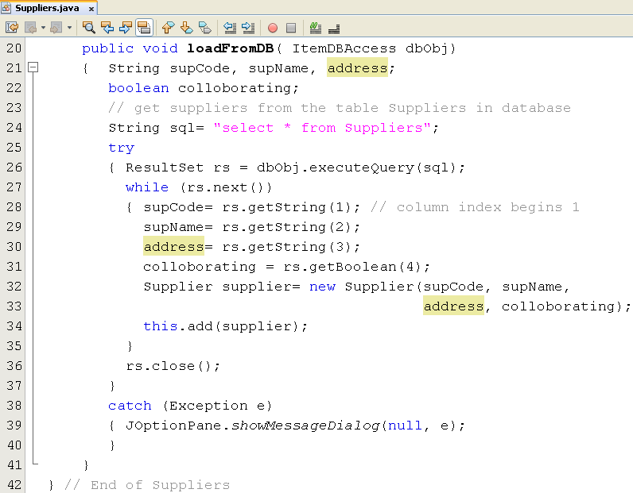
Demo 3…

Slide 44
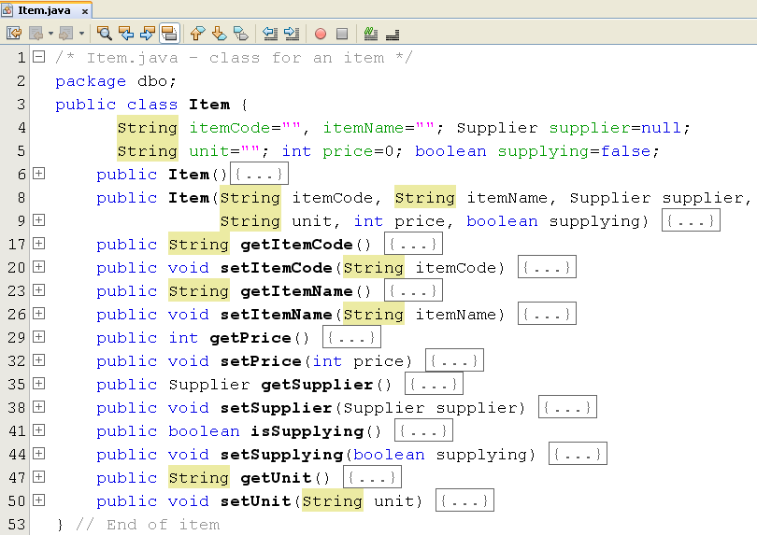
Demo 3…

Slide 45
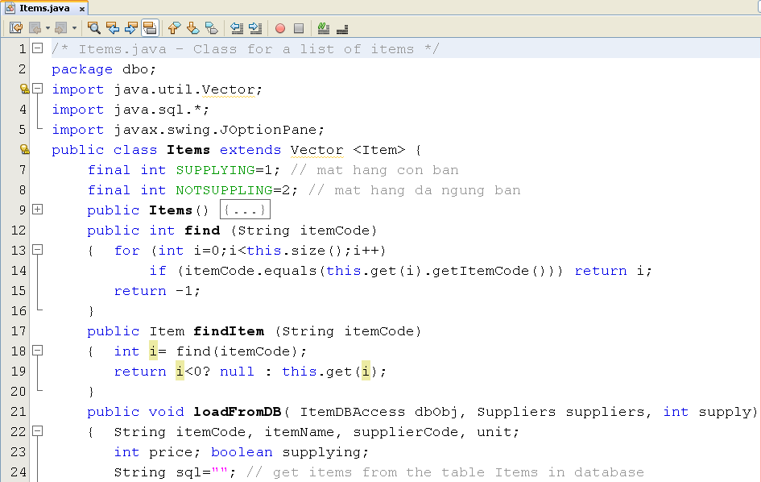
Demo 3…

Slide 46
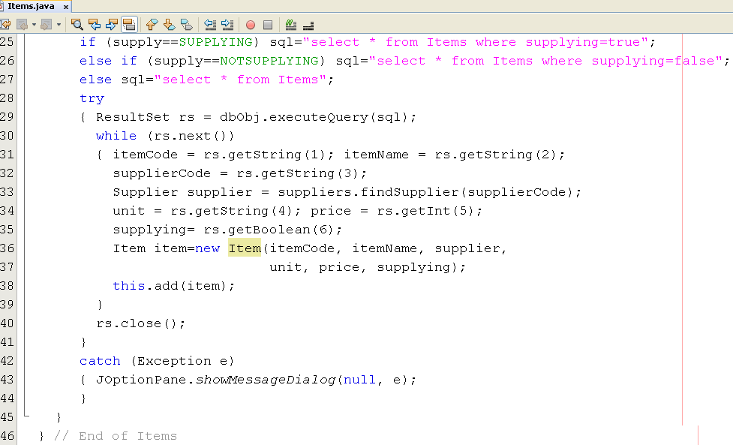
Demo 3…

Slide 47
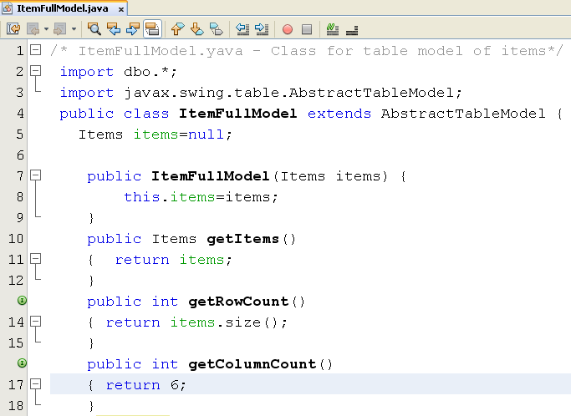

Demo 3…

Slide 48
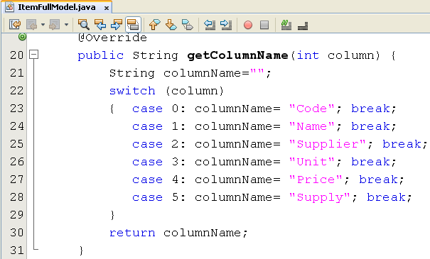
Demo 3…

Slide 49
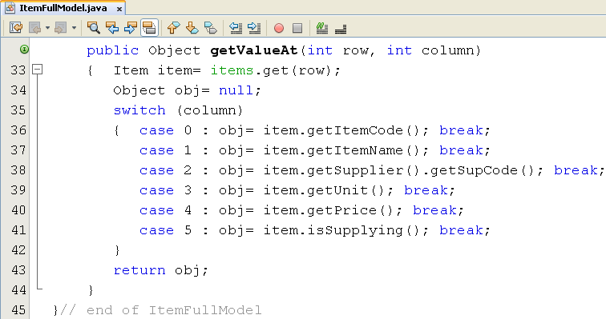
Demo 3…

Slide 50
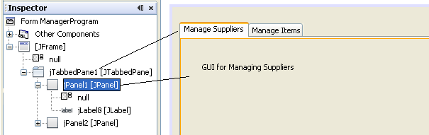
Demo 3…

Slide 51
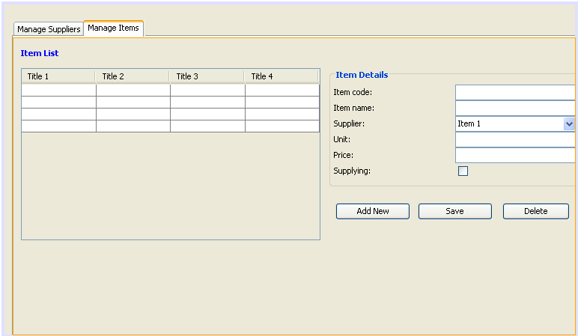
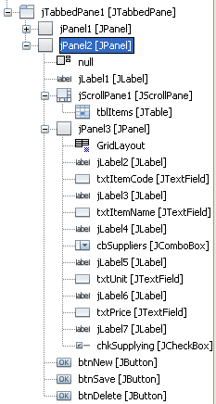
Demo 3…

Slide 52
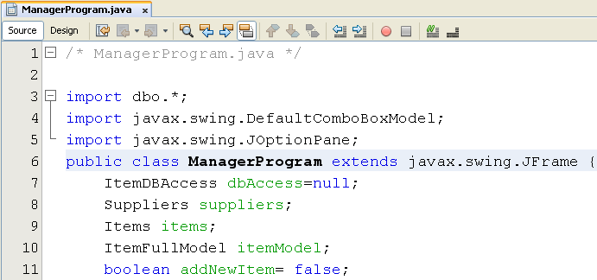
Demo 3…

Slide 53
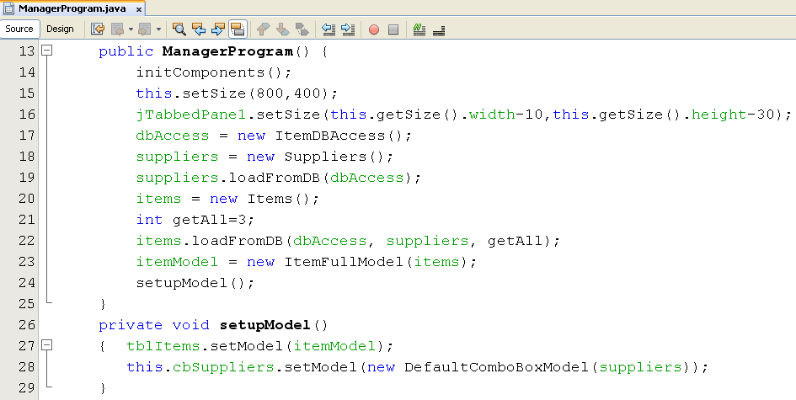
Demo 3…

Slide 54
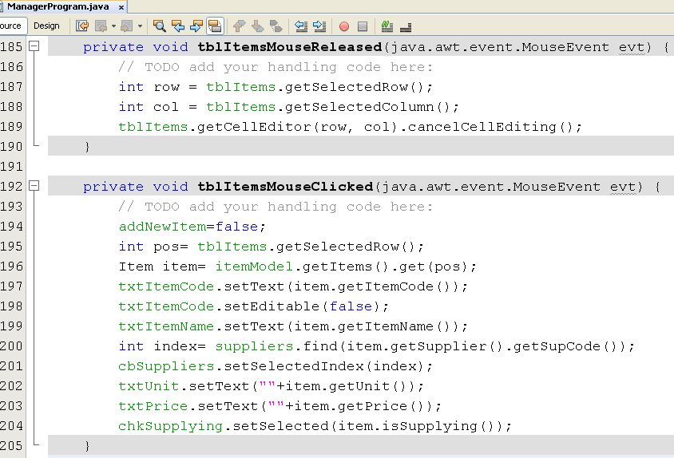
Demo 3…

Slide 55
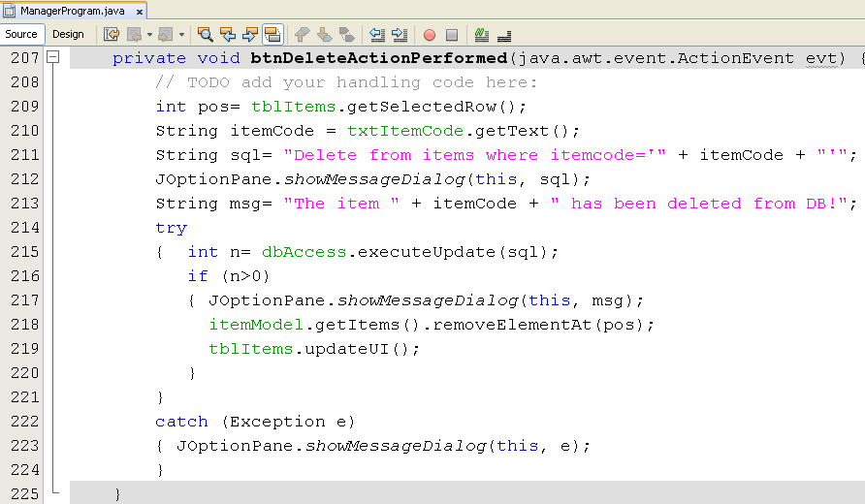
Demo 3…

Slide 56
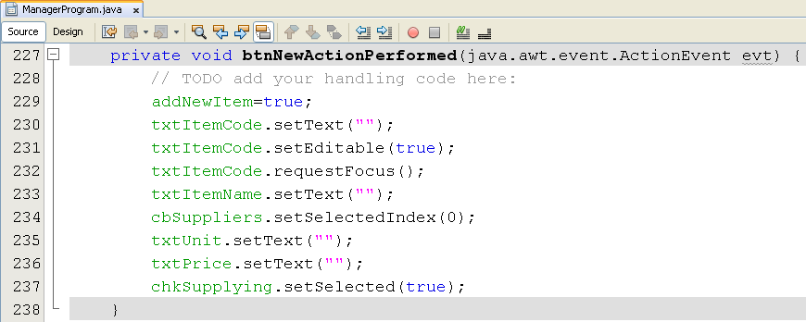
Demo 3…

Slide 57
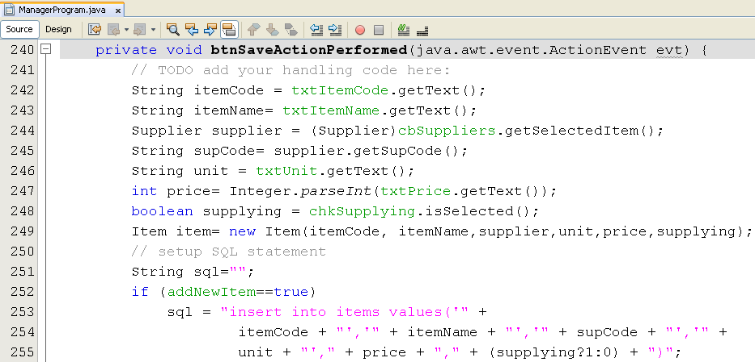
Demo 3…

Slide 58


Demo 3…

Slide 59
Summary
Introduction to databases
Relational Database Overview
JDBC and JDBC Drivers
Steps to develop a JDBC application.
Demonstrations

Slide 60
Thank You

